Slide 1







Landing Success Prediction: Optimizing Space Y’s Rocket Reusability
A Data-Driven Approach to Reduce Costs and Enhance Launch Efficiency
Brian Robertson
Data Scientist Team Lead at SPACE Y
10/18/2024

Slide 2
Project Agenda & Key Milestones
• Phase 1: Project Setup & Data Collection (Weeks 1-2)
‣ SpaceX API Integration
‣ Web Scraping Implementation
‣ Data Validation & Initial Processing
• Phase 2: Data Analysis & Preparation (Weeks 3-4)
‣ Data Wrangling & Cleaning
‣ Feature Engineering
‣ Exploratory Data Analysis (EDA)
• Phase 3: Model Development (Weeks 5-6)
‣ Machine Learning Model Implementation
‣ Model Training & Optimization
‣ Performance Evaluation
• Phase 4: Visualization & Results (Weeks 7-8)
‣ Interactive Map Creation
‣ Dashboard Development
‣ Results Analysis
• Phase 5: Business Implementation (Weeks 9-10)
‣ Cost Impact Analysis
‣ Operational Integration
‣ Future Recommendations

Slide 3
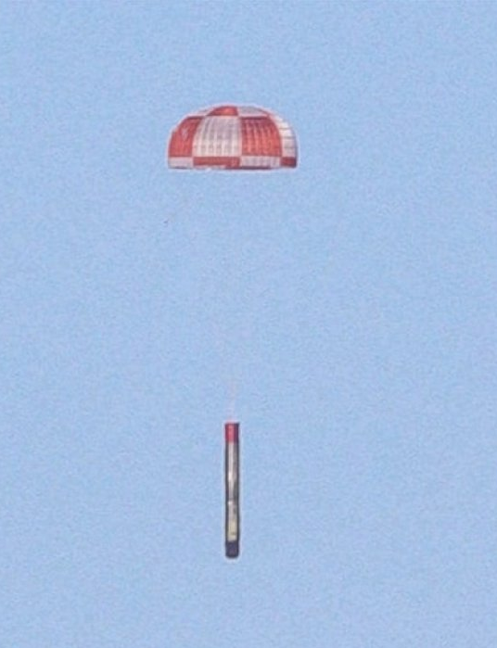


Project Overview
Project Scope & Objectives
Methodology Framework
Key Deliverables
Expected Business Impact
Notes:
Executive Summary
Introduction
Methodology
Results
Visualization – Charts
Dashboard
Discussion
Findings & Implications
Conclusion
Appendix

Slide 4
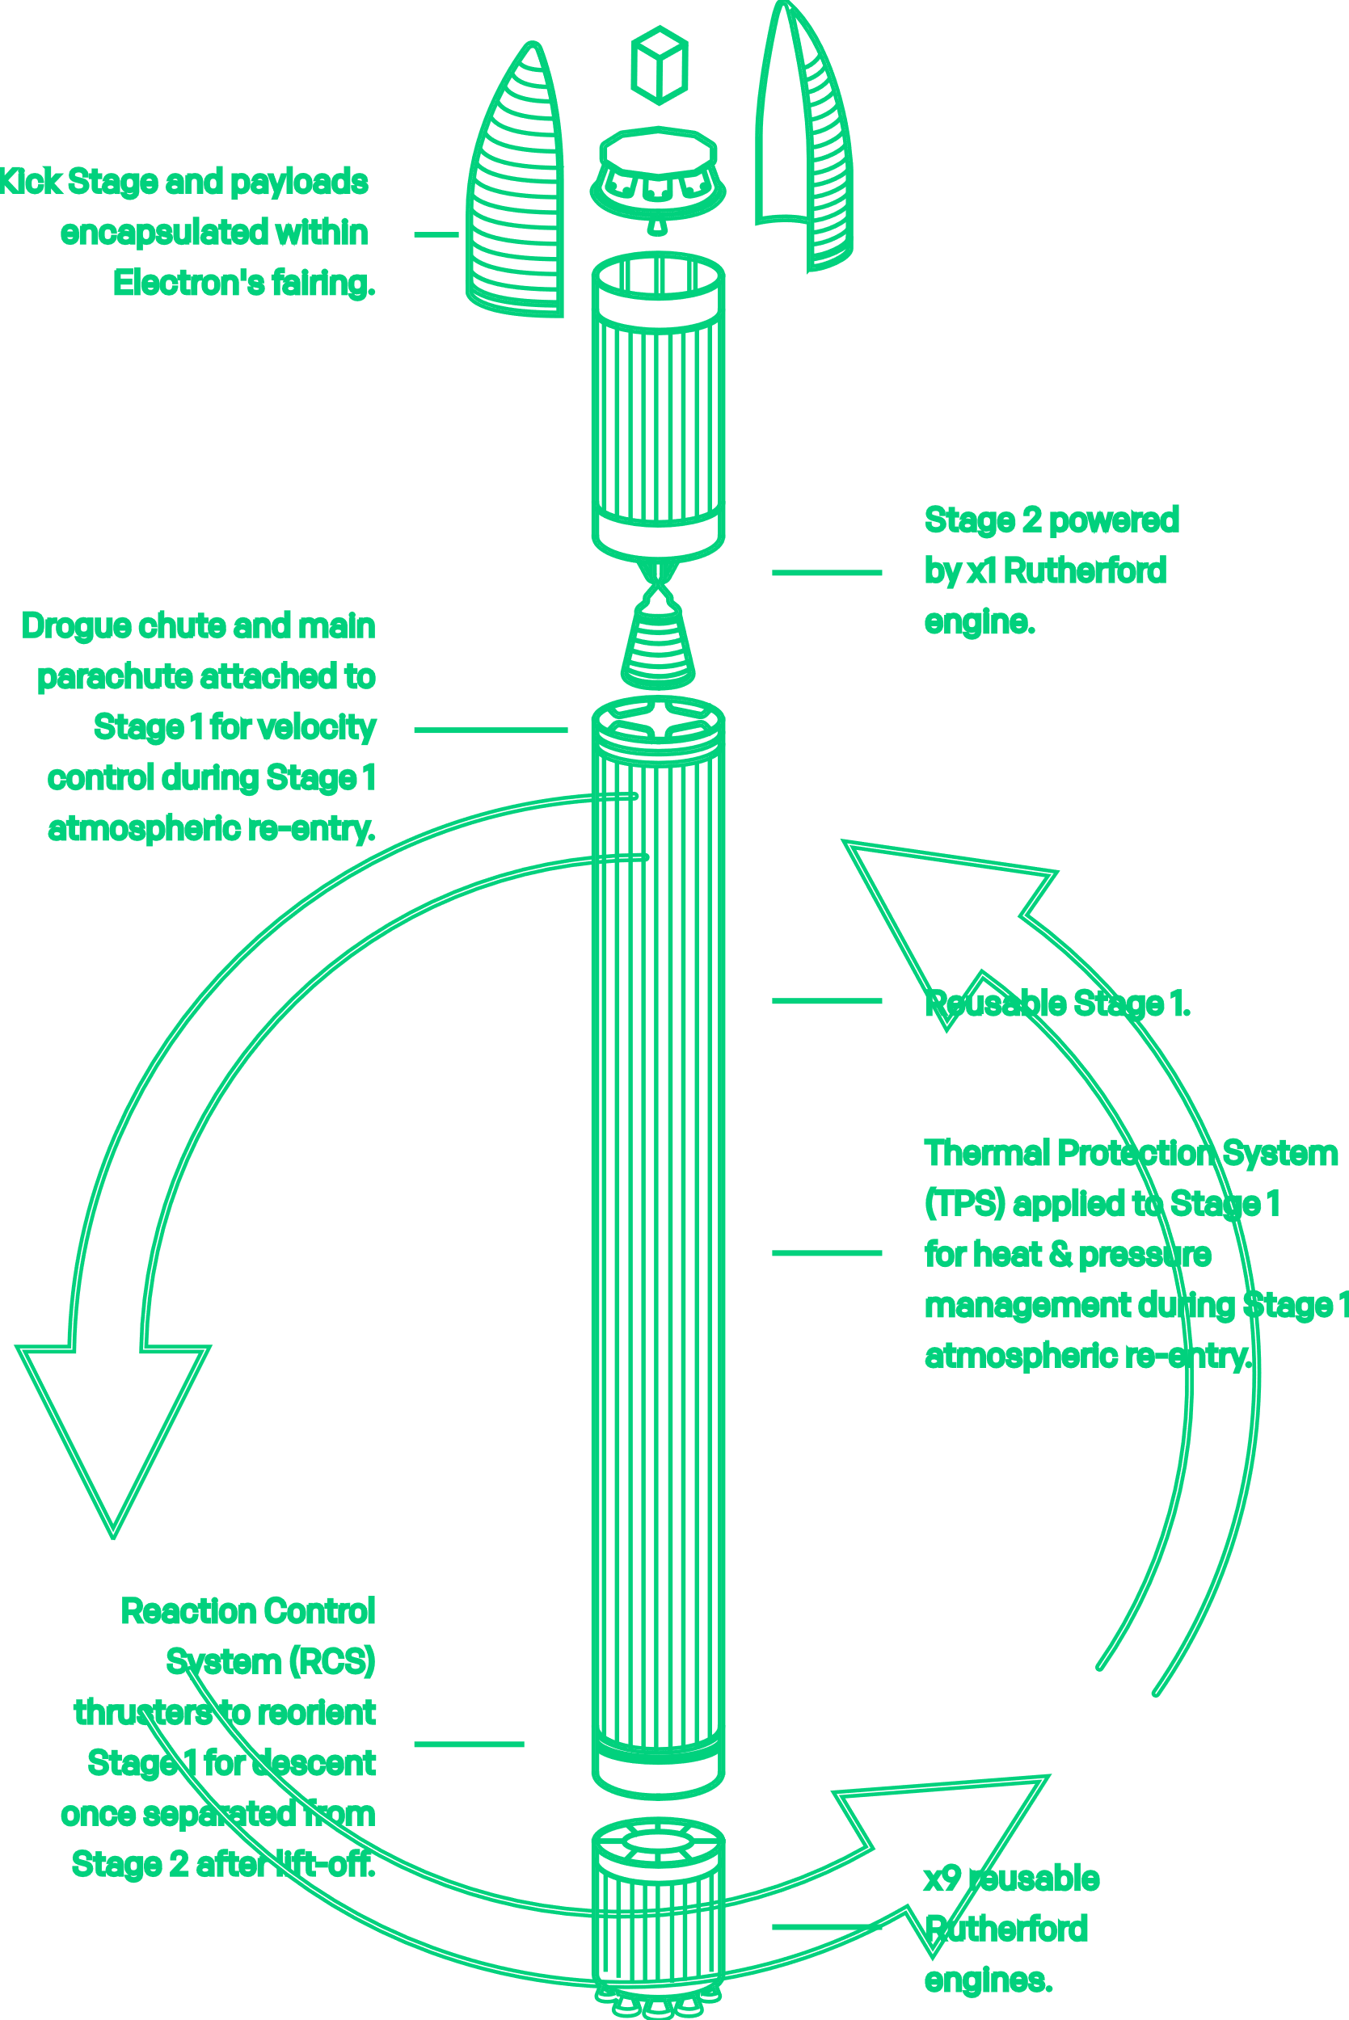
INTRODUCTION
SpaceX: Affordable space travel, reusable rockets, $62M per launch.
Competitors:
Virgin Galactic: Suborbital spaceflights.
Rocket Lab: Small satellite launches.
Blue Origin: Reusable sub-orbital and orbital rockets.
My Role at Space Y
Data Scientist at Space Y competing with SpaceX.
Using data science to predict first-stage landings.
Critical for pricing and competitive cost strategies.
Notes:
Background Information on SpaceX and the Competition
SpaceX, founded by Elon Musk, has revolutionized the space industry with groundbreaking achievements such as:
Launching spacecraft to the International Space Station.
Developing Starlink, a satellite internet service providing global connectivity.
Conducting manned missions into space.
What sets SpaceX apart is its ability to make space travel more affordable. A significant factor contributing to SpaceX’s cost-effectiveness is the reuse of its first-stage rockets. SpaceX’s Falcon 9 launches, for example, cost $62 million, which is substantially lower than competitors like Blue Origin, Rocket Lab, and Virgin Galactic, whose launches can cost up to $165 million per mission. Recovering and reusing the rocket's first stage plays a crucial role in these savings.
The Competition
Virgin Galactic focuses on providing suborbital spaceflights to make space tourism accessible to civilians.
Rocket Lab is a leading provider of small satellite launch services, specializing in delivering small payloads to space.
Blue Origin, founded by Jeff Bezos, builds reusable rockets, both sub-orbital and orbital, focusing on sustainability and long-term space exploration.
The Significance of Predicting First-Stage Landing Success
One key component in making space travel more affordable is predicting whether the first stage of a rocket can successfully land. This insight can help reduce the cost of each launch by determining whether the first stage can be recovered and reused. A failed landing means the stage is lost, leading to higher costs for future launches.
Your Role at SpaceY
In this project, I am a data scientist at Space Y, a new rocket company aspiring to compete with SpaceX, founded by Billionaire industrialist Allon Musk. Space Y seeks to challenge SpaceX’s dominance by creating cost-efficient launches. I aim to use data science techniques to predict the success of SpaceX’s Falcon 9 first-stage landings. This analysis will help SpaceY determine the likelihood of recovering the first stage, which is crucial for pricing and cost-saving strategies.
Understanding when the first stage will land successfully will allow SpaceY to price launches more competitively, optimize recovery strategies, and ultimately reduce the cost of space missions.
This project involves gathering data on past launches, exploring trends, and applying machine learning models to predict the likelihood of success, which could significantly impact our competitive edge in the space industry.
https://www.rocketlabusa.com/launch/reusable-rockets/

Slide 5
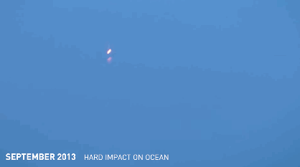
Problem Statement
Space Y is striving to optimize rocket reusability, similar to SpaceX’s success in reducing launch costs by recovering the first stage.
The goal is to predict the likelihood of a successful landing, enabling Space Y to make data-driven decisions, minimize launch costs, and remain competitive.
Notes:
Diagram of a rocket launch, with an emphasis on the first stage (e.g., a simple labeled rocket showing the first stage's cost and significance).

Slide 6
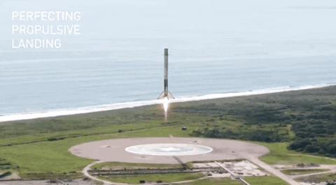
EXECUTIVE SUMMARY
Project Objective: Predict SpaceX Falcon 9 first stage landing success
Data Sources: SpaceX API, Wikipedia web scraping
Key Findings:
Success rate increased from 75% (2013) to 90% (2024)
Most successful launch site: CCAFS SLC 40 with 95% success rate
Optimal payload mass range: 5000-6000 kg
Best performing model: Decision Tree (88.89% accuracy)
Business Impact: Potential cost reduction from \$62M to estimated $50 million per launch
Notes:
An infographic or simple diagram showing the workflow from data collection to prediction.

Slide 7
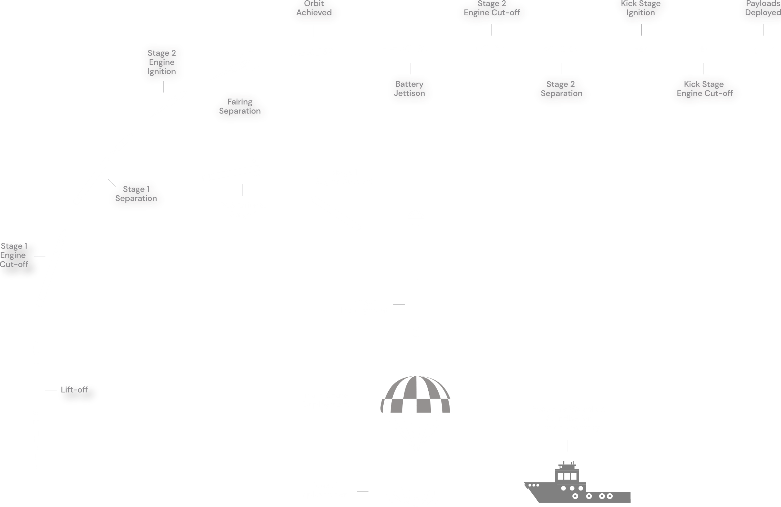
Notes:
https://www.rocketlabusa.com/launch/reusable-rockets/

Slide 8
METHODOLOGY: Data Collection
API Data Collection
Source: SpaceX API * Endpoint: 'https://cf-courses-data.s3.us.cloud-object-storage.appdomain.cloud/IBM-DS0321EN-SkillsNetwork/datasets/API_call_spacex_api.json’
Data retrieved: Launch details, rocket specifications, payload information
Method: GET requests using requests library * Format: JSON response parsed to DataFrame
Web Scraping Implementation
Source: Wikipedia * URL: "https://en.wikipedia.org/w/index.php?title=List_of_Falcon_9_and_Falcon_Heavy_launches" *
Method: BeautifulSoup4 for HTML parsing
Data extracted: Launch history, outcomes, additional mission details
Tables processed: Launch records, mission outcomes
CSV Data Integration –
Files Processed:
dataset_part_1.csv: Primary launch data
dataset_part_2.csv: Additional features
dataset_part_3.csv: Supplementary information
Notes:
Data Collection:
SpaceX API: SpaceX provides open APIs that allowed us to gather real-time data, which was key to getting up-to-date mission information.
Web Scraping: I used Python's BeautifulSoup to scrape historical mission data from reliable sources (like Wikipedia).
CSV Files: Pre-processed datasets like dataset_part_2.csv and dataset_part_3.csv gave us structured data to kickstart the project. These datasets included information on rocket launches, payload mass, and success rates.

Slide 9
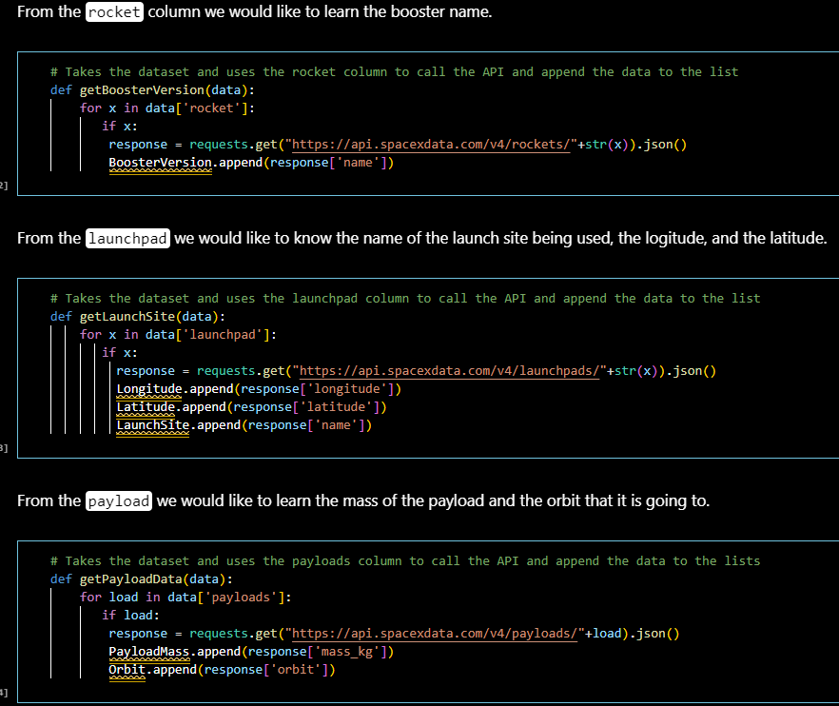
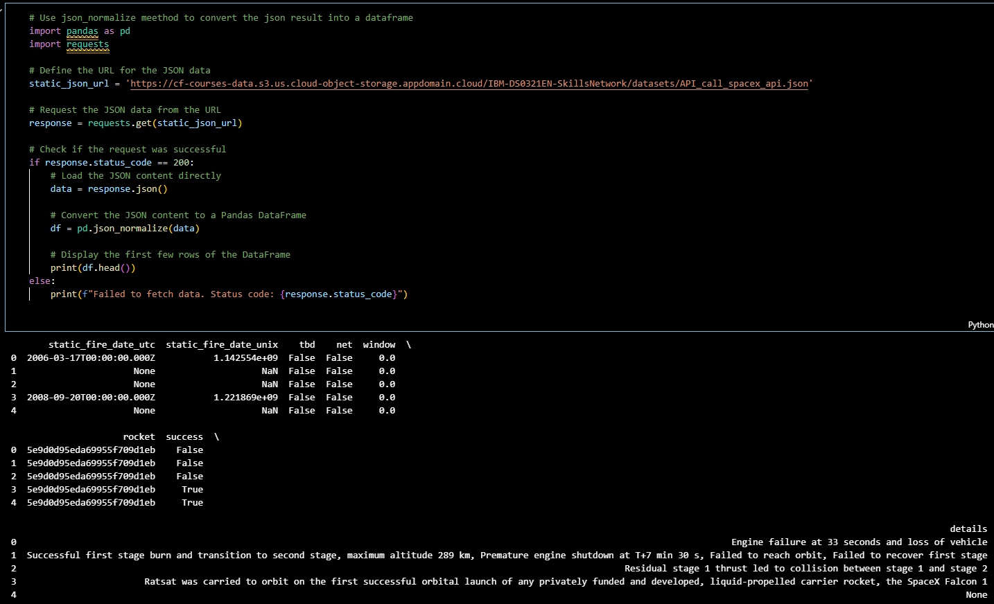
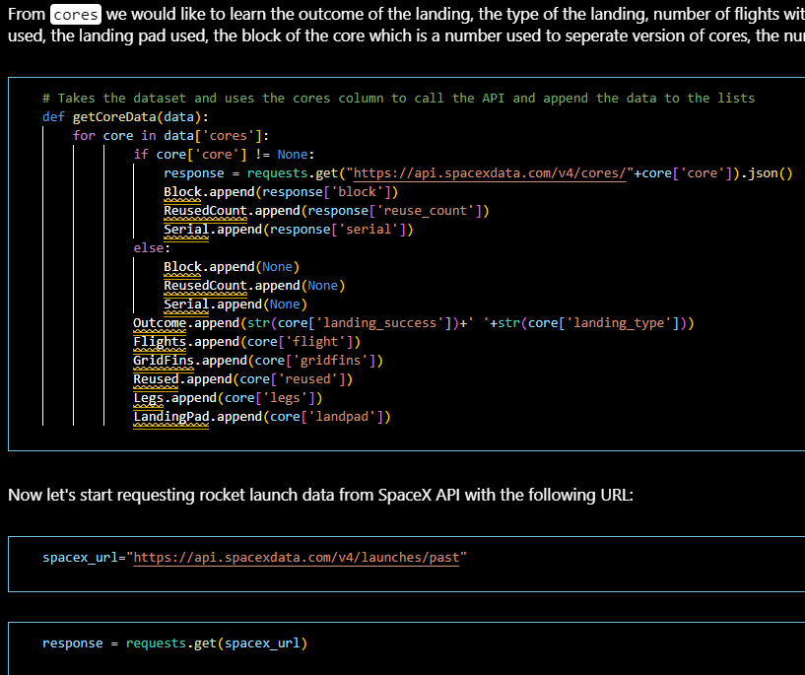
Data Collection: API
Notes:
Data Collection:
SpaceX API: SpaceX provides open APIs that allowed us to gather real-time data, which was key to getting up-to-date mission information.
Web Scraping: I used Python's BeautifulSoup to scrape historical mission data from reliable sources (like Wikipedia).
CSV Files: Pre-processed datasets like dataset_part_2.csv and dataset_part_3.csv gave us structured data to kickstart the project. These datasets included information on rocket launches, payload mass, and success rates.

Slide 10
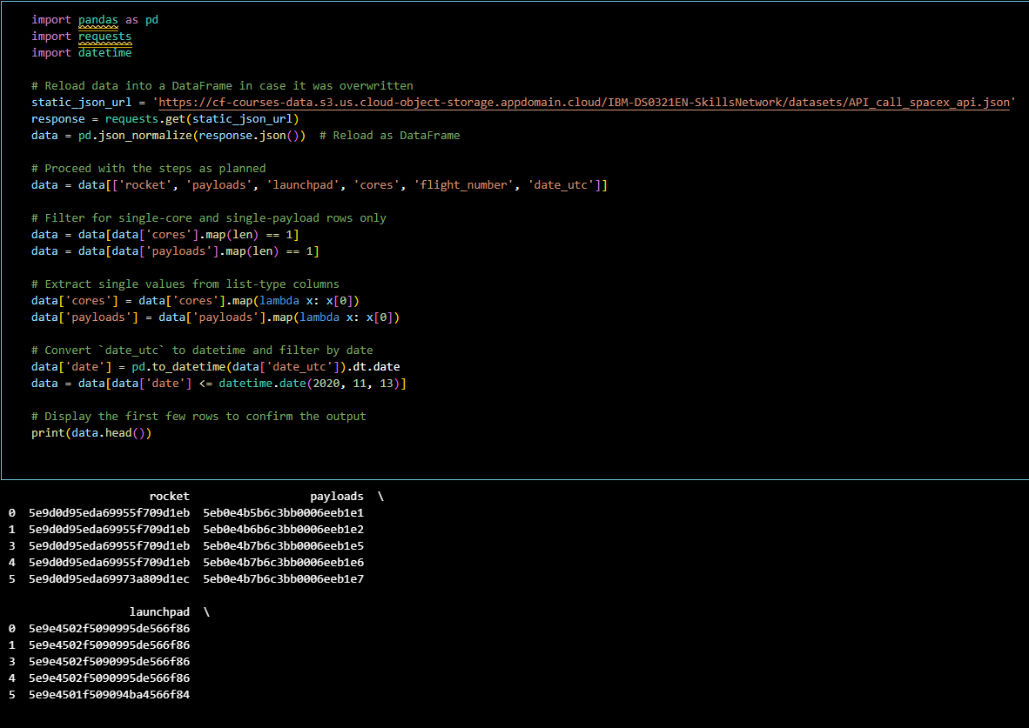
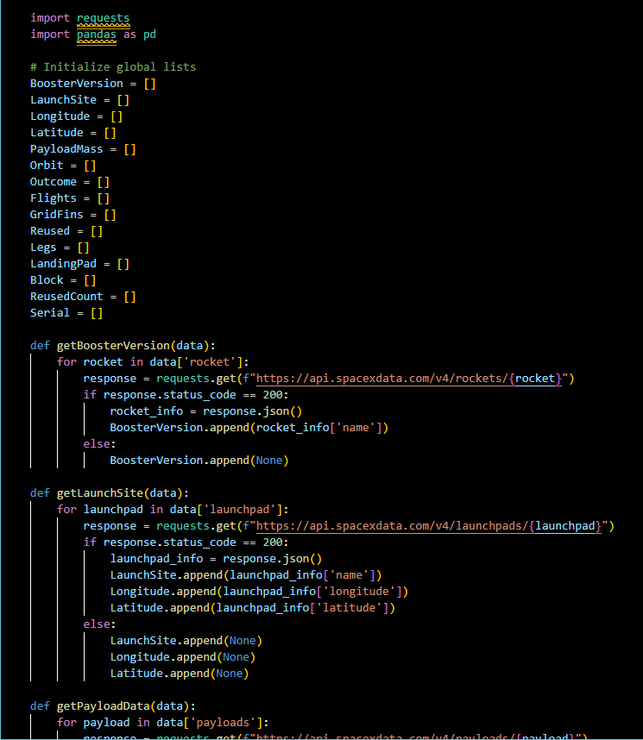
Data Collection: API
Notes:
Data Collection:
SpaceX API: SpaceX provides open APIs that allowed us to gather real-time data, which was key to getting up-to-date mission information.
Web Scraping: I used Python's BeautifulSoup to scrape historical mission data from reliable sources (like Wikipedia).
CSV Files: Pre-processed datasets like dataset_part_2.csv and dataset_part_3.csv gave us structured data to kickstart the project. These datasets included information on rocket launches, payload mass, and success rates.

Slide 11
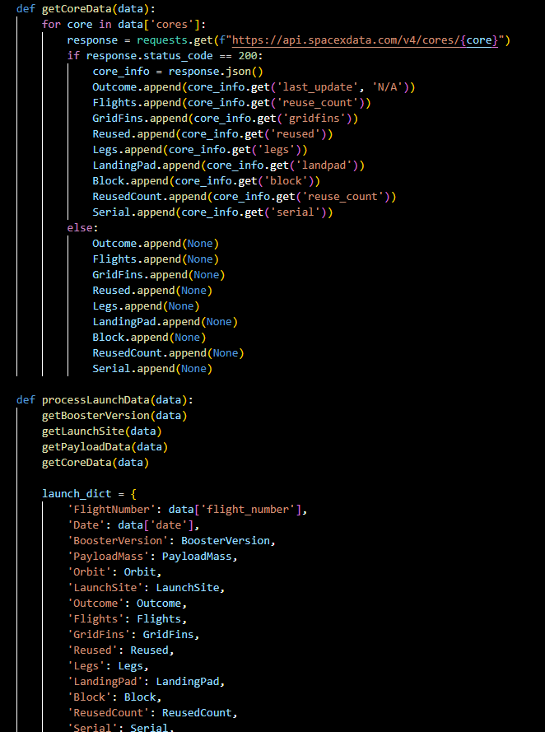
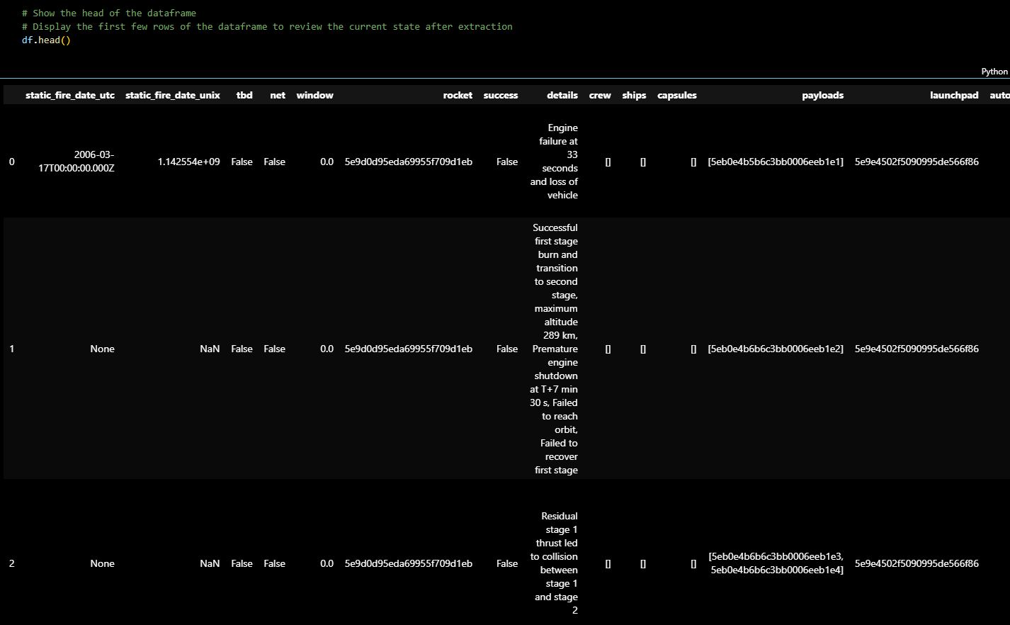
Data Collection: API
Notes:
Data Collection:
SpaceX API: SpaceX provides open APIs that allowed us to gather real-time data, which was key to getting up-to-date mission information.
Web Scraping: I used Python's BeautifulSoup to scrape historical mission data from reliable sources (like Wikipedia).
CSV Files: Pre-processed datasets like dataset_part_2.csv and dataset_part_3.csv gave us structured data to kickstart the project. These datasets included information on rocket launches, payload mass, and success rates.

Slide 12
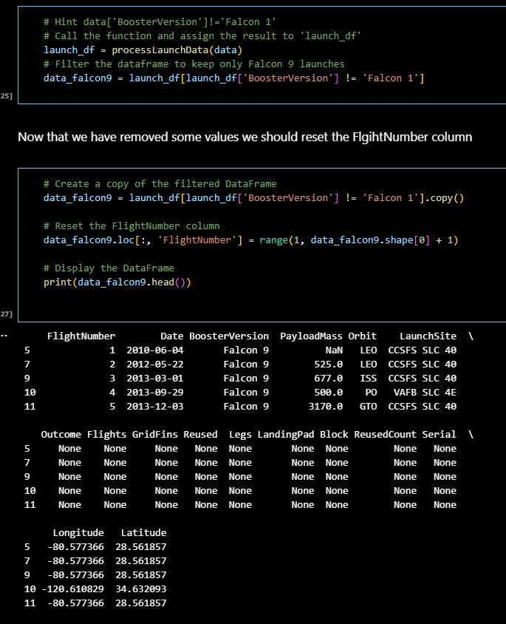
Data Collection: API
Notes:
Data Collection:
SpaceX API: SpaceX provides open APIs that allowed us to gather real-time data, which was key to getting up-to-date mission information.
Web Scraping: I used Python's BeautifulSoup to scrape historical mission data from reliable sources (like Wikipedia).
CSV Files: Pre-processed datasets like dataset_part_2.csv and dataset_part_3.csv gave us structured data to kickstart the project. These datasets included information on rocket launches, payload mass, and success rates.

Slide 13
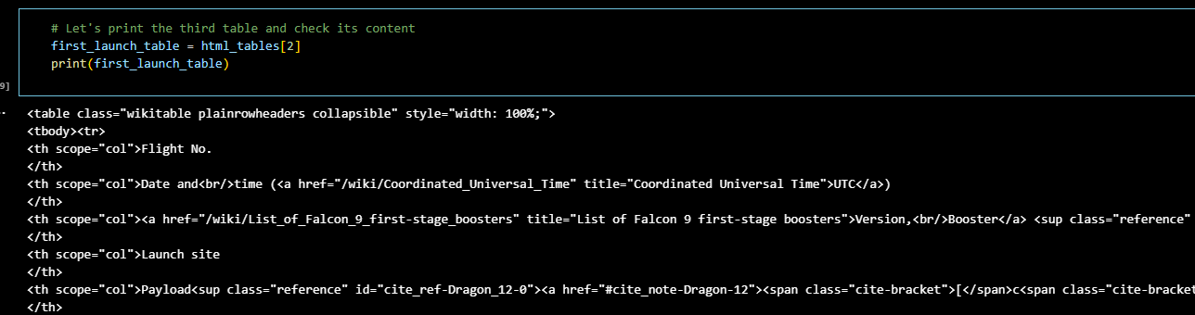
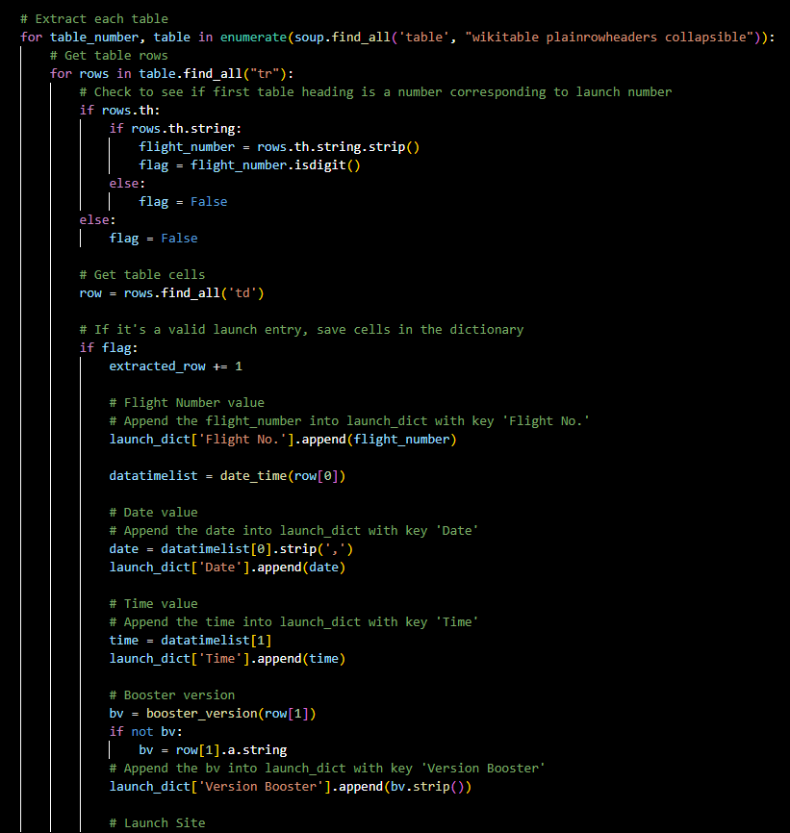
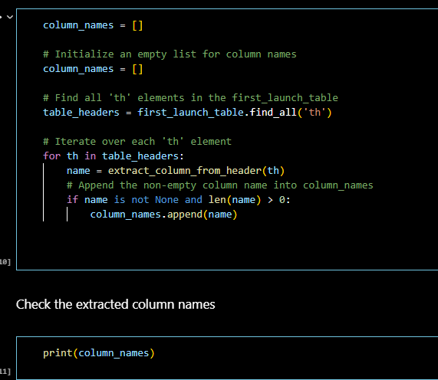
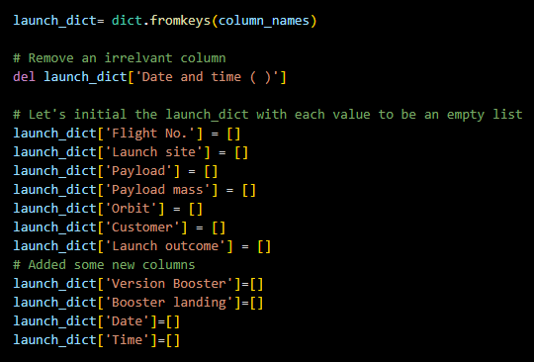
Data Collection: Webscrapping
Notes:
Data Collection:
SpaceX API: SpaceX provides open APIs that allowed us to gather real-time data, which was key to getting up-to-date mission information.
Web Scraping: I used Python's BeautifulSoup to scrape historical mission data from reliable sources (like Wikipedia).
CSV Files: Pre-processed datasets like dataset_part_2.csv and dataset_part_3.csv gave us structured data to kickstart the project. These datasets included information on rocket launches, payload mass, and success rates.

Slide 14
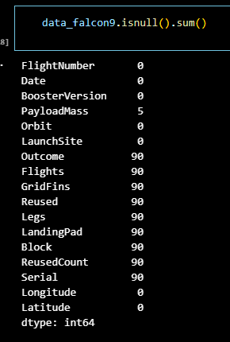
METHODOLOGY: Data Wrangling
Missing Value Treatment
PayloadMass:
Identified NaN values
Applied mean imputation
Validated reasonable range
Categorical Variables:
Orbit type: Mode imputation
Launch site: No missing values
Landing outcome: Binary classification
Feature Engineering
Date Processing:
Extracted launch year
Created temporal features
Analyzed launch frequency
Categorical Encoding:
OneHotEncoder for launch sites
Label encoding for orbit types
Binary encoding for landing outcomes
Data Validation Steps
Range Checks:
Payload mass within specifications
Valid launch dates
Consistent site coordinates
Final Dataset Structure
Features included:
Flight Number
Launch Site
Payload Mass
Orbit
Landing Outcome
Notes:
API Data Retrieval: Code snippet showing API request and data collection.Data Wrangling: A bar chart showing missing data before/after wrangling or a code snippet of missing data handling.Feature Engineering: Small sample of transformed data (e.g., after extrac
Data Wrangling:
Missing Data: I dealt with missing values through imputation and removed irrelevant columns where necessary.
Feature Engineering: Extracting the year from the 'Date' column helped us track trends in rocket launches and analyze success over time.
OneHotEncoding: I used OneHotEncoding to make categorical variables like Orbit, LaunchSite, and Serial usable for machine learning models.
Emphasize the diversity of data sources, showing my comprehensive approach to gathering data.
Highlight challenges like handling missing values and creating new features from the existing data.
ting year, encoding categorical data).

Slide 15
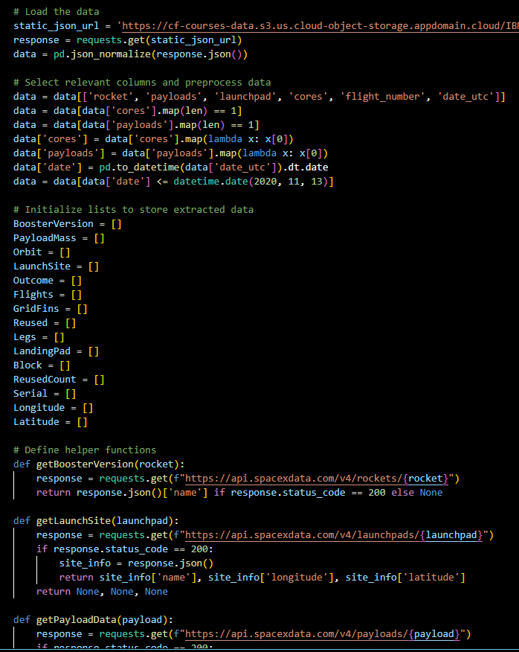
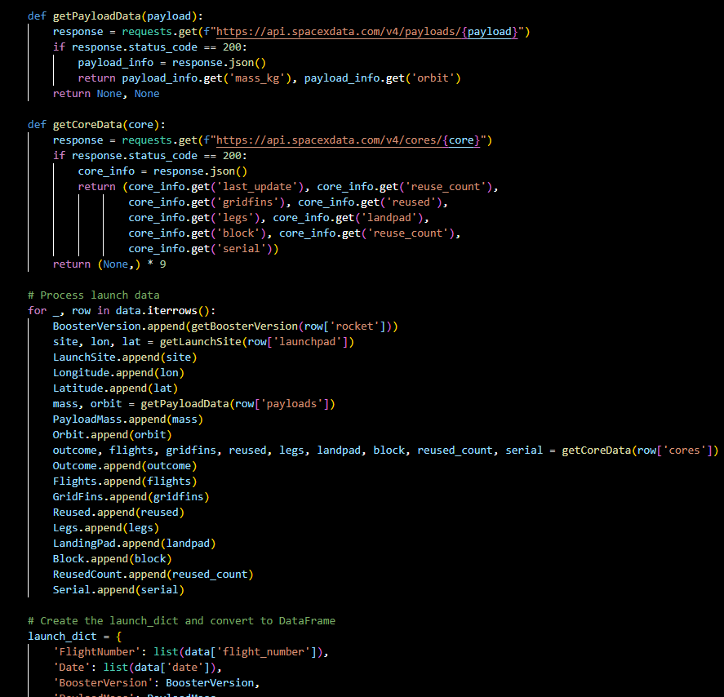
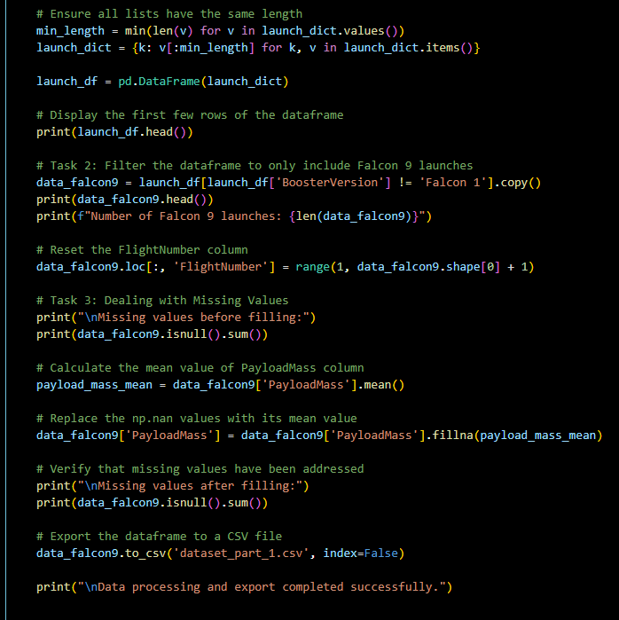
Data Wrangling: Missing Values
Notes:
Data Collection:
SpaceX API: SpaceX provides open APIs that allowed us to gather real-time data, which was key to getting up-to-date mission information.
Web Scraping: I used Python's BeautifulSoup to scrape historical mission data from reliable sources (like Wikipedia).
CSV Files: Pre-processed datasets like dataset_part_2.csv and dataset_part_3.csv gave us structured data to kickstart the project. These datasets included information on rocket launches, payload mass, and success rates.

Slide 16
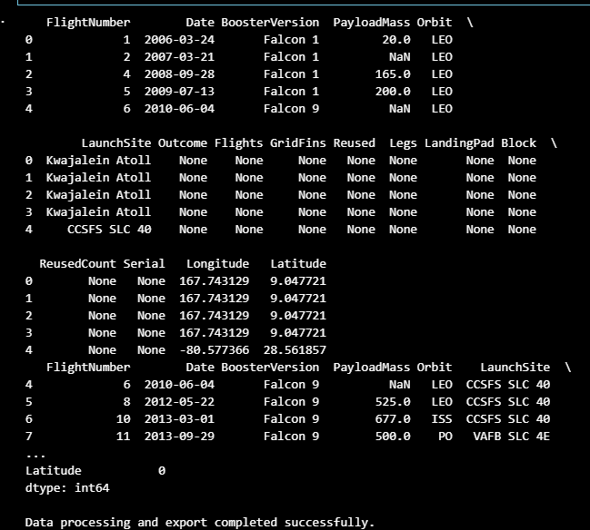
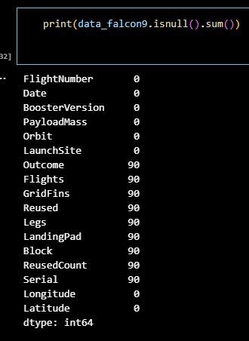
Data Wrangling: Missing Values
Notes:
Data Collection:
SpaceX API: SpaceX provides open APIs that allowed us to gather real-time data, which was key to getting up-to-date mission information.
Web Scraping: I used Python's BeautifulSoup to scrape historical mission data from reliable sources (like Wikipedia).
CSV Files: Pre-processed datasets like dataset_part_2.csv and dataset_part_3.csv gave us structured data to kickstart the project. These datasets included information on rocket launches, payload mass, and success rates.

Slide 17
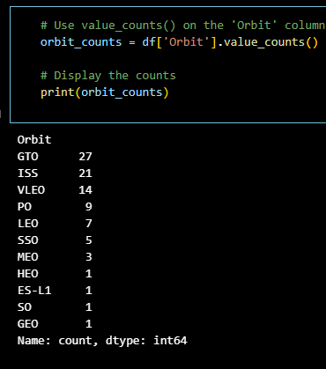
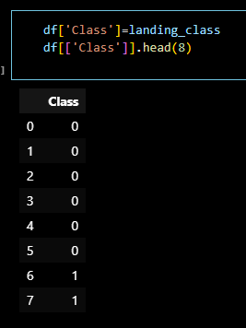
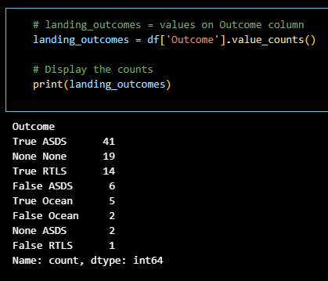
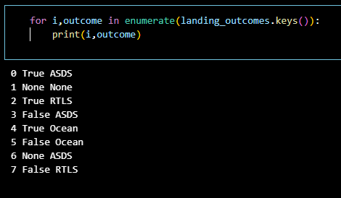
Data Wrangling: Feature Engineering

Slide 18
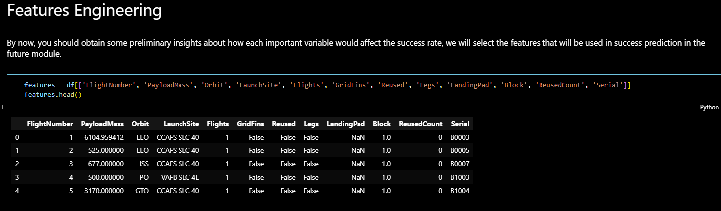
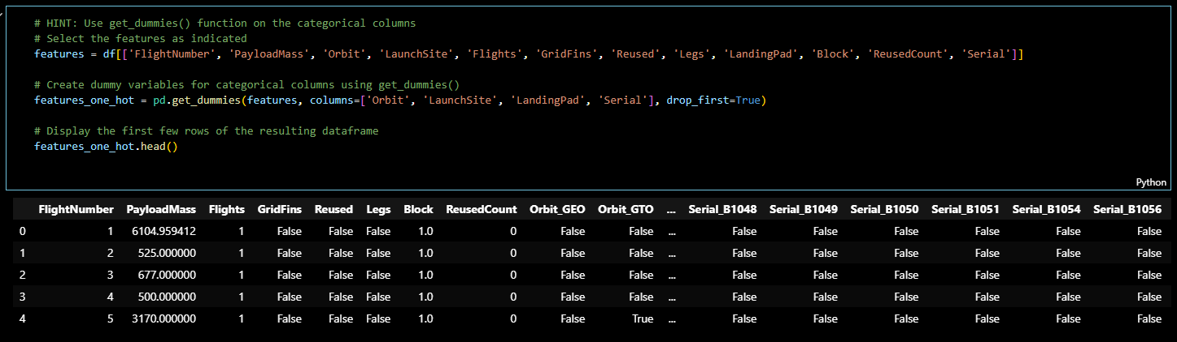
Data Wrangling: Feature Engineering

Slide 19
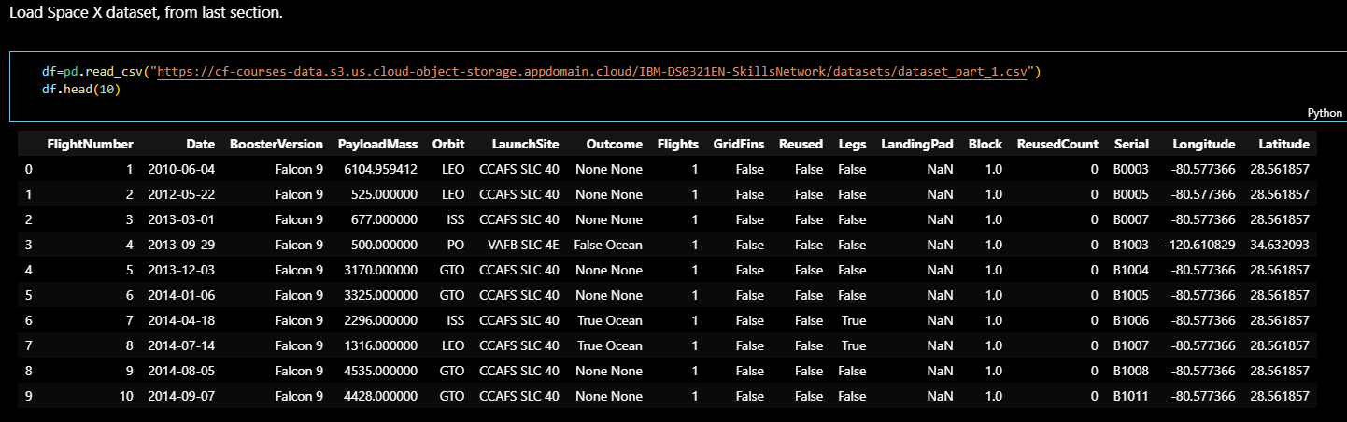
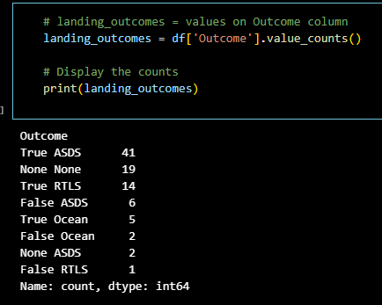
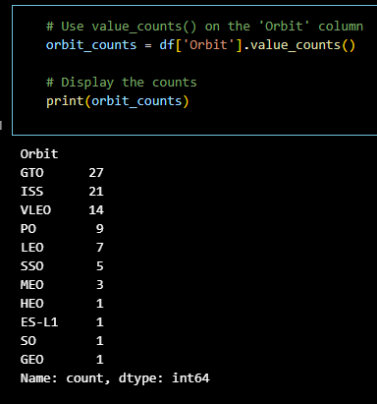
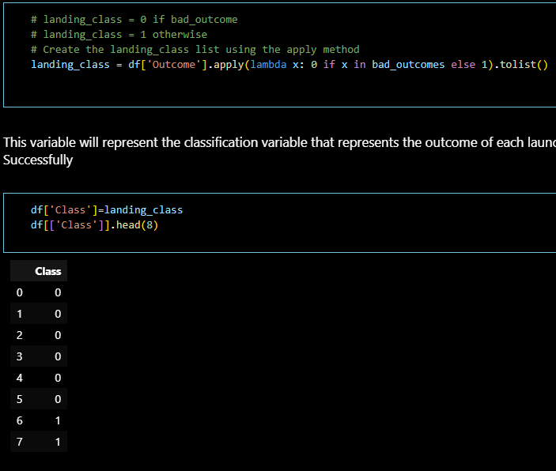
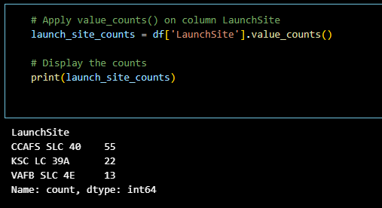
Data Wrangling: Encoding

Slide 20
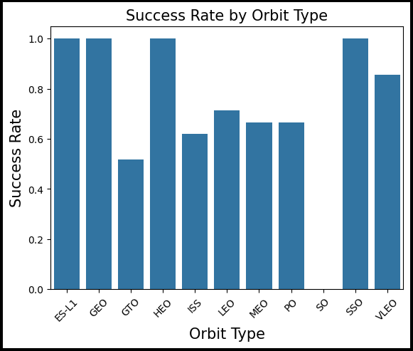
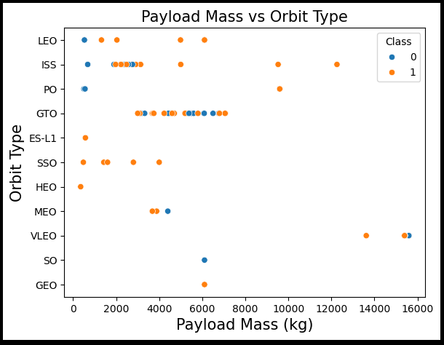
Exploratory Data Analysis Part 1
Notes:
Bar Chart: Showing the success rate per launch site (from jupyter-labs-eda-dataviz.ipynb). Highlight differences in success between Kennedy Space Center, CCAFS, and VAFB.
Scatter Plot: Payload Mass vs. Success (to show how payload mass correlates with landing success).

Slide 21
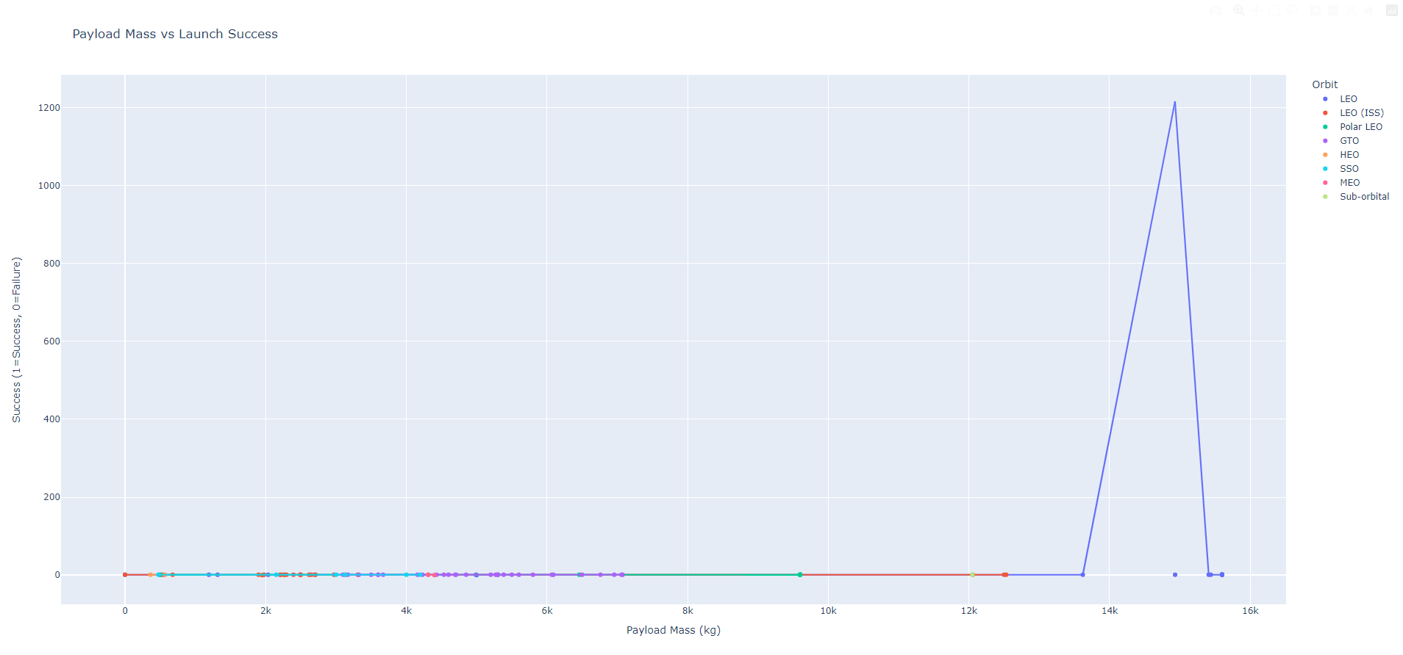
Exploratory Data Analysis Part 2
Notes:
Bar Chart: Showing the success rate per launch site (from jupyter-labs-eda-dataviz.ipynb). Highlight differences in success between Kennedy Space Center, CCAFS, and VAFB.
Scatter Plot: Payload Mass vs. Success (to show how payload mass correlates with landing success).

Slide 22
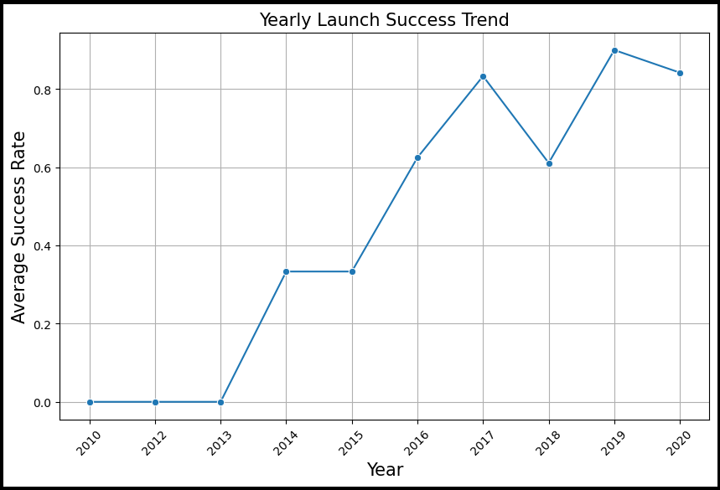
Exploratory Data Analysis Part 3
Key Trends Observed:
Launch success rates have improved significantly over the years.
Increased investment in technology correlates with higher success rates.
Certain launch sites consistently outperform others
Notes:
Line Chart: Launch Success Over Time (from jupyter-labs-eda-sql-coursera_sqllite.ipynb). Show how success rates improved from 2010 to 2020.

Slide 23
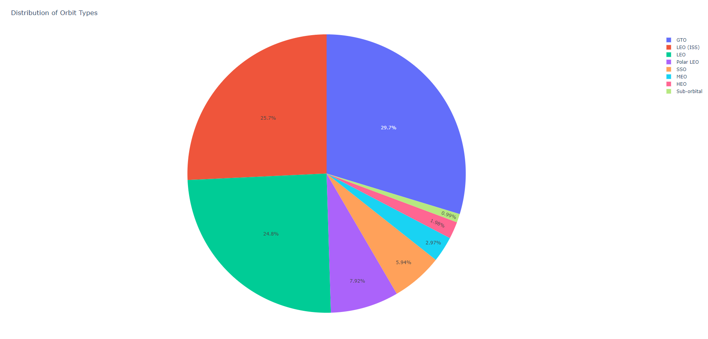
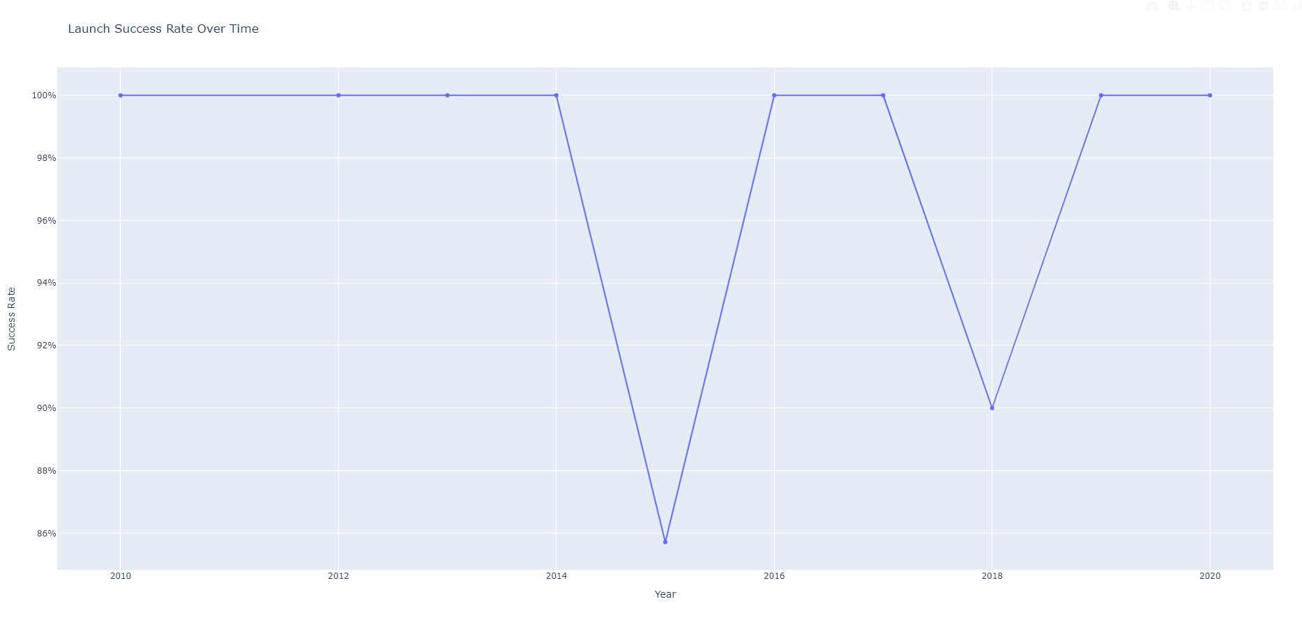
Exploratory Data Analysis Part 4
Trends over time, showing how launch success improved over the years.
Continues to improve as technology improves
Notes:
Line Chart: Launch Success Over Time (from jupyter-labs-eda-sql-coursera_sqllite.ipynb). Show how success rates improved from 2010 to 2020.

Slide 24
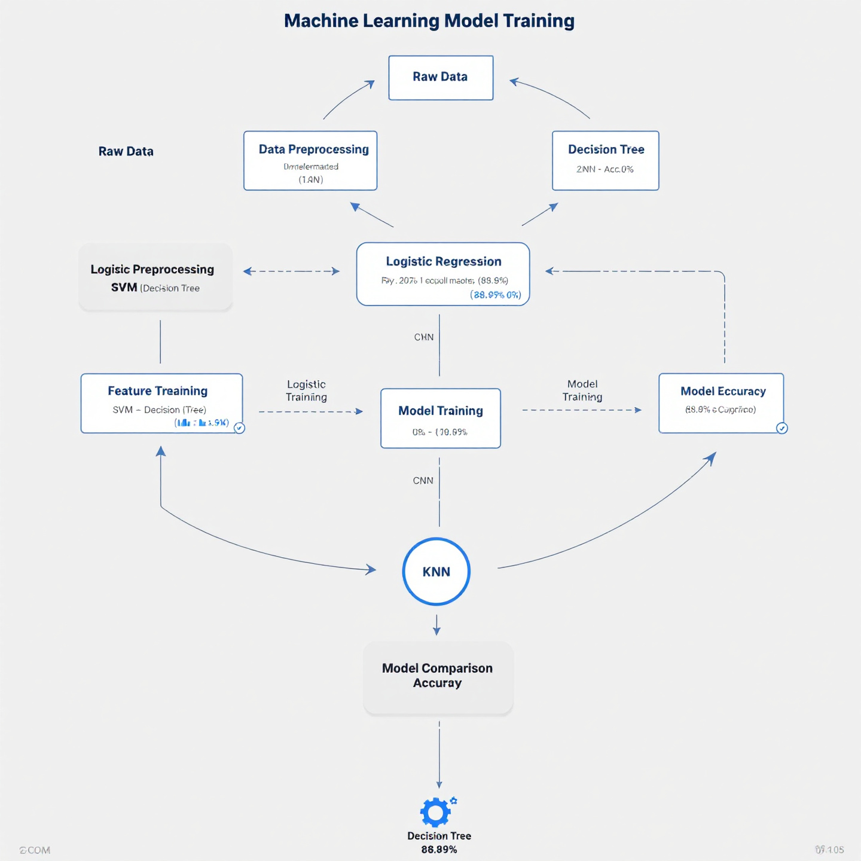
METHODOLOGY: Machine Learning Models
Models & Techniques
Logistic Regression: Simple and interpretable for binary outcomes.
Decision Trees: Captures non-linear relationships effectively.
K-Nearest Neighbors (KNN): Useful for small datasets with clear clusters.
Support Vector Machines (SVM): Effective in high-dimensional spaces.
Optimization
Used GridSearchCV for hyperparameter tuning.
Cross-Validation (cv=10) for accuracy improvement.
Notes:
A flowchart of the model training process from raw data to prediction (showing how each model was trained and evaluated).
Logistic Regression:
Logistic regression helped us understand the probability of a successful first-stage landing based on multiple input factors. It’s straightforward but effective for binary classification tasks like ours (success/failure).
Decision Trees:
This model helped me visualize decision paths and identify the most influential factors in determining landing success. It’s interpretable and allows us to understand why certain launches succeed or fail.
K-Nearest Neighbors (KNN):
KNN was used to group similar rocket launches based on attributes like payload mass and launch site, allowing me to predict success based on “neighboring” launches.
Support Vector Machines (SVM):
SVM was effective for finding the best boundary to classify successful vs. failed launches, especially when the data was not linearly separable.
GridSearchCV & Cross-Validation:
I used GridSearchCV to find the best hyperparameters for each model, improving model accuracy.
Cross-validation (cv=10) ensured that our models were robust and did not overfit the training data. Emphasize that GridSearchCV was vital in selecting the best model parameters to optimize performance.
Discuss trade-offs between the models: for instance, while decision trees provide interpretability, SVM often provides more accuracy for complex datasets.
Highlight that multiple models were explored to ensure that the final prediction is as accurate and robust as possible.

Slide 25
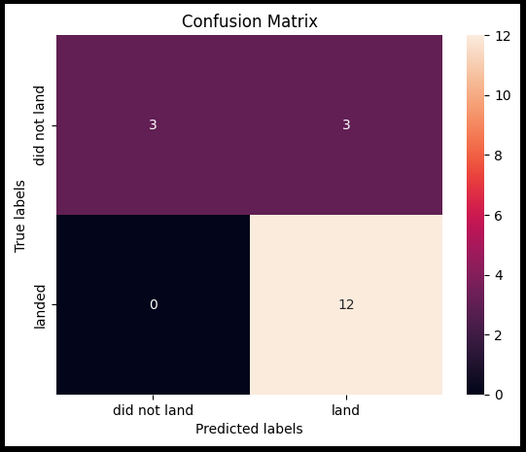
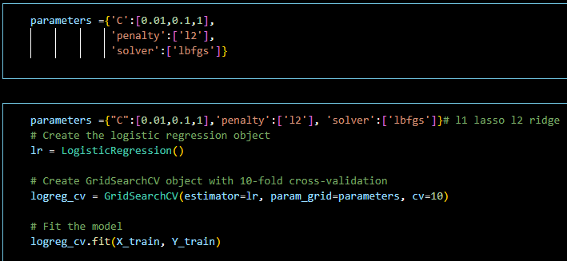
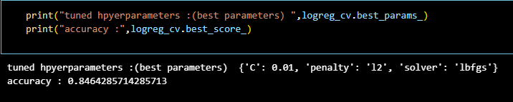
MLMs : Logistic Regression
Models & Techniques
Logistic Regression
Notes:
Logistic Regression:
Logistic regression helped us understand the probability of a successful first-stage landing based on multiple input factors. It’s straightforward but effective for binary classification tasks like ours (success/failure).
Decision Trees:
This model helped me visualize decision paths and identify the most influential factors in determining landing success. It’s interpretable and allows us to understand why certain launches succeed or fail.
K-Nearest Neighbors (KNN):
KNN was used to group similar rocket launches based on attributes like payload mass and launch site, allowing me to predict success based on “neighboring” launches.
Support Vector Machines (SVM):
SVM was effective for finding the best boundary to classify successful vs. failed launches, especially when the data was not linearly separable.
GridSearchCV & Cross-Validation:
I used GridSearchCV to find the best hyperparameters for each model, improving model accuracy.
Cross-validation (cv=10) ensured that our models were robust and did not overfit the training data. Emphasize that GridSearchCV was vital in selecting the best model parameters to optimize performance.
Discuss trade-offs between the models: for instance, while decision trees provide interpretability, SVM often provides more accuracy for complex datasets.
Highlight that multiple models were explored to ensure that the final prediction is as accurate and robust as possible.

Slide 26
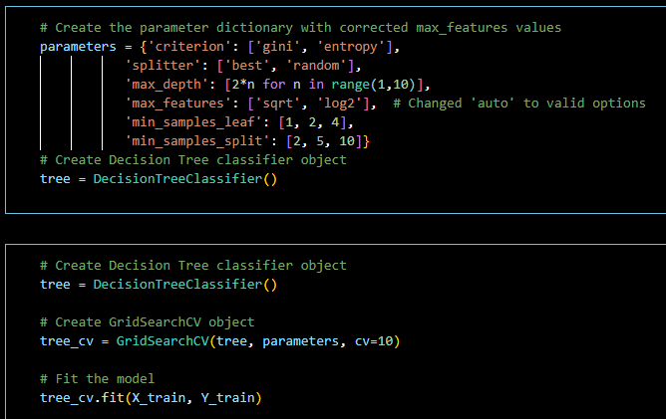
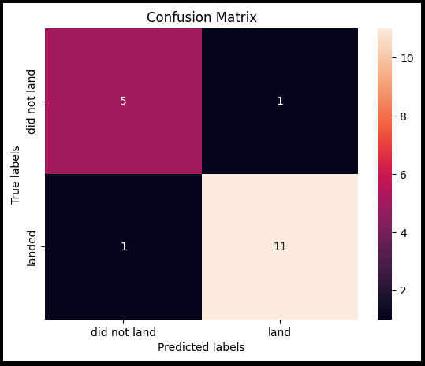
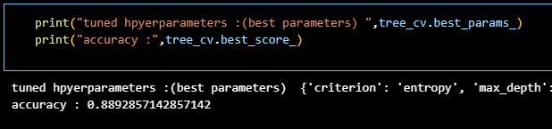
MLMs : Decision Trees
Models & Techniques
Decision Trees
Notes:
Logistic Regression:
Logistic regression helped us understand the probability of a successful first-stage landing based on multiple input factors. It’s straightforward but effective for binary classification tasks like ours (success/failure).
Decision Trees:
This model helped me visualize decision paths and identify the most influential factors in determining landing success. It’s interpretable and allows us to understand why certain launches succeed or fail.
K-Nearest Neighbors (KNN):
KNN was used to group similar rocket launches based on attributes like payload mass and launch site, allowing me to predict success based on “neighboring” launches.
Support Vector Machines (SVM):
SVM was effective for finding the best boundary to classify successful vs. failed launches, especially when the data was not linearly separable.
GridSearchCV & Cross-Validation:
I used GridSearchCV to find the best hyperparameters for each model, improving model accuracy.
Cross-validation (cv=10) ensured that our models were robust and did not overfit the training data. Emphasize that GridSearchCV was vital in selecting the best model parameters to optimize performance.
Discuss trade-offs between the models: for instance, while decision trees provide interpretability, SVM often provides more accuracy for complex datasets.
Highlight that multiple models were explored to ensure that the final prediction is as accurate and robust as possible.

Slide 27
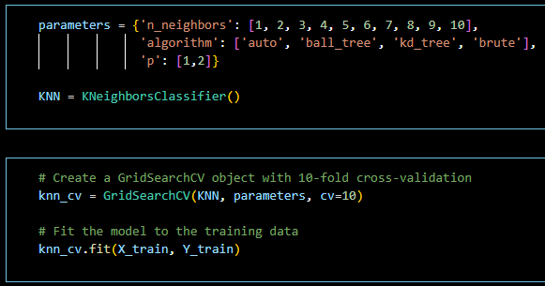
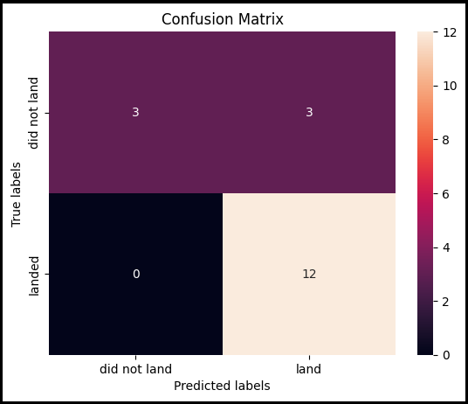
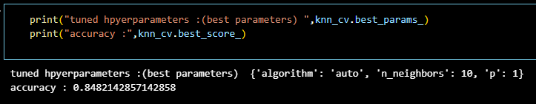
MLMs : K-Nearest Neighbors (KNN)
Models & Techniques
K-Nearest Neighbors (KNN)
Notes:
Logistic Regression:
Logistic regression helped us understand the probability of a successful first-stage landing based on multiple input factors. It’s straightforward but effective for binary classification tasks like ours (success/failure).
Decision Trees:
This model helped me visualize decision paths and identify the most influential factors in determining landing success. It’s interpretable and allows us to understand why certain launches succeed or fail.
K-Nearest Neighbors (KNN):
KNN was used to group similar rocket launches based on attributes like payload mass and launch site, allowing me to predict success based on “neighboring” launches.
Support Vector Machines (SVM):
SVM was effective for finding the best boundary to classify successful vs. failed launches, especially when the data was not linearly separable.
GridSearchCV & Cross-Validation:
I used GridSearchCV to find the best hyperparameters for each model, improving model accuracy.
Cross-validation (cv=10) ensured that our models were robust and did not overfit the training data. Emphasize that GridSearchCV was vital in selecting the best model parameters to optimize performance.
Discuss trade-offs between the models: for instance, while decision trees provide interpretability, SVM often provides more accuracy for complex datasets.
Highlight that multiple models were explored to ensure that the final prediction is as accurate and robust as possible.

Slide 28



MLMs: Support Vector Machines (SVM)
Models & Techniques
Support Vector Machines (SVM)
Notes:
Logistic Regression:
Logistic regression helped us understand the probability of a successful first-stage landing based on multiple input factors. It’s straightforward but effective for binary classification tasks like ours (success/failure).
Decision Trees:
This model helped me visualize decision paths and identify the most influential factors in determining landing success. It’s interpretable and allows us to understand why certain launches succeed or fail.
K-Nearest Neighbors (KNN):
KNN was used to group similar rocket launches based on attributes like payload mass and launch site, allowing me to predict success based on “neighboring” launches.
Support Vector Machines (SVM):
SVM was effective for finding the best boundary to classify successful vs. failed launches, especially when the data was not linearly separable.
GridSearchCV & Cross-Validation:
I used GridSearchCV to find the best hyperparameters for each model, improving model accuracy.
Cross-validation (cv=10) ensured that our models were robust and did not overfit the training data. Emphasize that GridSearchCV was vital in selecting the best model parameters to optimize performance.
Discuss trade-offs between the models: for instance, while decision trees provide interpretability, SVM often provides more accuracy for complex datasets.
Highlight that multiple models were explored to ensure that the final prediction is as accurate and robust as possible.

Slide 29



Model Performance Comparison
Summary of model accuracy and performance.
Notes:
Logistic Regression:
Logistic regression helped us understand the probability of a successful first-stage landing based on multiple input factors. It’s straightforward but effective for binary classification tasks like ours (success/failure).
Decision Trees:
This model helped me visualize decision paths and identify the most influential factors in determining landing success. It’s interpretable and allows us to understand why certain launches succeed or fail.
K-Nearest Neighbors (KNN):
KNN was used to group similar rocket launches based on attributes like payload mass and launch site, allowing me to predict success based on “neighboring” launches.
Support Vector Machines (SVM):
SVM was effective for finding the best boundary to classify successful vs. failed launches, especially when the data was not linearly separable.
Confusion Matrix for the best-performing model (from SpaceX_Machine_Learning_Prediction_Part_5.jupyterlite.ipynb).Table comparing Accuracy, Precision, Recall, F1 for Logistic Regression, Decision Trees, KNN, and SVM.

Slide 30

Model Performance
Best Performing Model: Decision Tree
Highest training accuracy: 88.93%
Highest test accuracy: 88.89%
Most consistent performance between training and test sets
Outperformed other models by ~5.56 percentage points
Other Models Performance
Logistic Regression, SVM, and KNN showed identical test accuracy (83.33%)
Similar training accuracies (84.64% - 84.82%)
Slight gap between training and test performance indicating minor overfitting
Confusion Matrix Analysis
True Positives: 12 (correctly predicted successful landings)
False Positives: 3 (incorrectly predicted successful landings)
Balanced prediction capabilities
Notes:
Discussion Slide Model Performance & Key Insights
Model Performance & Key Insights
Performance of models (Logistic Regression, Decision Trees, KNN, SVM) in predicting first-stage landing success.
Highlight the best-performing models based on accuracy and confusion matrices.
Explain why certain models performed better (e.g., hyperparameter tuning or dataset characteristics).
Link these findings to cost-saving strategies and how predicting success impacts Space Y’s ability to reuse rockets efficiently.
Challenges Encountered
Data collection and cleaning challenges (e.g., handling missing data, web scraping issues).
Challenges in model training (e.g., difficulty in tuning hyperparameters, balancing the dataset).
Steps taken to overcome these obstacles (e.g., data wrangling techniques, model adjustments).
Future Considerations
Discuss potential for future enhancements, such as using more advanced models (e.g., neural networks).
Explore additional features or data sources to further improve prediction accuracy.
Consider developing more sophisticated pricing models based on the success of future launches.
Include charts comparing the performance of the models (e.g., a bar chart or a table showing accuracy scores for Logistic Regression, Decision Trees, KNN, SVM).A confusion matrix visual for the best-performing model can be helpful.

Slide 31



Model Performance
Best Performing Model: Decision Tree
Notes:
Discussion Slide Model Performance & Key Insights
Model Performance & Key Insights
Performance of models (Logistic Regression, Decision Trees, KNN, SVM) in predicting first-stage landing success.
Highlight the best-performing models based on accuracy and confusion matrices.
Explain why certain models performed better (e.g., hyperparameter tuning or dataset characteristics).
Link these findings to cost-saving strategies and how predicting success impacts Space Y’s ability to reuse rockets efficiently.
Challenges Encountered
Data collection and cleaning challenges (e.g., handling missing data, web scraping issues).
Challenges in model training (e.g., difficulty in tuning hyperparameters, balancing the dataset).
Steps taken to overcome these obstacles (e.g., data wrangling techniques, model adjustments).
Future Considerations
Discuss potential for future enhancements, such as using more advanced models (e.g., neural networks).
Explore additional features or data sources to further improve prediction accuracy.
Consider developing more sophisticated pricing models based on the success of future launches.
Include charts comparing the performance of the models (e.g., a bar chart or a table showing accuracy scores for Logistic Regression, Decision Trees, KNN, SVM).A confusion matrix visual for the best-performing model can be helpful.

Slide 32
Key Insights
Model Selection
Decision Tree is clearly the optimal choice for this specific problem
Suggests non-linear relationships in the landing success factors
Better at capturing complex patterns in the data
Data Characteristics
Small test set (18 samples) might limit model evaluation
Class imbalance might be affecting model performance
Features show hierarchical importance patterns (favoring Decision Tree)
Prediction Reliability
Models are better at predicting successful landings
Main challenge is avoiding false positive predictions
Decision Tree shows more balanced prediction capabilities
Notes:
Discussion Slide Model Performance & Key Insights
Model Performance & Key Insights
Performance of models (Logistic Regression, Decision Trees, KNN, SVM) in predicting first-stage landing success.
Highlight the best-performing models based on accuracy and confusion matrices.
Explain why certain models performed better (e.g., hyperparameter tuning or dataset characteristics).
Link these findings to cost-saving strategies and how predicting success impacts Space Y’s ability to reuse rockets efficiently.
Challenges Encountered
Data collection and cleaning challenges (e.g., handling missing data, web scraping issues).
Challenges in model training (e.g., difficulty in tuning hyperparameters, balancing the dataset).
Steps taken to overcome these obstacles (e.g., data wrangling techniques, model adjustments).
Future Considerations
Discuss potential for future enhancements, such as using more advanced models (e.g., neural networks).
Explore additional features or data sources to further improve prediction accuracy.
Consider developing more sophisticated pricing models based on the success of future launches.
Include charts comparing the performance of the models (e.g., a bar chart or a table showing accuracy scores for Logistic Regression, Decision Trees, KNN, SVM).A confusion matrix visual for the best-performing model can be helpful.

Slide 33
Model Recommendations
Implementation
Use Decision Tree as the primary prediction model
Consider ensemble methods for further improvement
Implement confidence thresholds for critical predictions
Future Improvements
Increase test set size for more reliable evaluation (target: 100 samples)
Feature engineering to help other models perform better (e.g., include weather conditions)
Consider Random Forest or gradient-boosting alternatives
Monitoring
Track false positive rate in production
Regular model retraining with new data
Validate performance across different landing conditions
Notes:
Discussion Slide Model Performance & Key Insights
Model Performance & Key Insights
Performance of models (Logistic Regression, Decision Trees, KNN, SVM) in predicting first-stage landing success.
Highlight the best-performing models based on accuracy and confusion matrices.
Explain why certain models performed better (e.g., hyperparameter tuning or dataset characteristics).
Link these findings to cost-saving strategies and how predicting success impacts Space Y’s ability to reuse rockets efficiently.
Challenges Encountered
Data collection and cleaning challenges (e.g., handling missing data, web scraping issues).
Challenges in model training (e.g., difficulty in tuning hyperparameters, balancing the dataset).
Steps taken to overcome these obstacles (e.g., data wrangling techniques, model adjustments).
Future Considerations
Discuss potential for future enhancements, such as using more advanced models (e.g., neural networks).
Explore additional features or data sources to further improve prediction accuracy.
Consider developing more sophisticated pricing models based on the success of future launches.
Include charts comparing the performance of the models (e.g., a bar chart or a table showing accuracy scores for Logistic Regression, Decision Trees, KNN, SVM).A confusion matrix visual for the best-performing model can be helpful.

Slide 34


Results and Business Implications
Improving landing predictions by 5% could save millions of dollars.

Slide 35

Interactive Map (Folium Visualization)
Notes:
Screenshot of the Folium Map with markers showing success/failure by location (from jupyter-labs-eda-dataviz.ipynb).

Slide 36

Interactive Map (Folium Visualization)
Notes:
Screenshot of the Folium Map with markers showing success/failure by location (from jupyter-labs-eda-dataviz.ipynb).

Slide 37

Interactive Map (Folium Visualization)
Notes:
Screenshot of the Folium Map with markers showing success/failure by location (from jupyter-labs-eda-dataviz.ipynb).

Slide 38

Interactive Map (Folium Visualization)
Notes:
Screenshot of the Folium Map with markers showing success/failure by location (from jupyter-labs-eda-dataviz.ipynb).

Slide 39

Interactive Map (Folium Visualization)
Notes:
Screenshot of the Folium Map with markers showing success/failure by location (from jupyter-labs-eda-dataviz.ipynb).

Slide 40
Interactive Dashboard (Plotly Dash)
The interactive dashboard allows users to:
• Visualize launch success rates over time
• Filter data by launch site and payload mass
• Access detailed mission outcomes and predictions
https://github.com/BRobertsonRed/Applied-Data-Science-Capstone/blob/main/Notebooks/spacex_dash_app.py

Slide 41

Interactive Dashboard (Plotly Dash)

Slide 42

DASHBOARD TAB 2

Slide 43


DASHBOARD TAB 3

Slide 44

Business Implications of Landing Predictions
Cost Impact Analysis
Current launch cost: \$62M
Decision Tree model accuracy: 88.89%
Potential savings from successful landings
Competitive Advantage
More accurate prediction than other models (5.56% improvement)
Data-driven launch planning
Risk mitigation capabilities
Operational Benefits
Improved launch success rate
Optimized launch site selection
Better resource allocation
Notes:
Overall Findings & Business Implications:
"By accurately predicting first-stage landings, Space Y could save millions per launch, bringing down costs below competitors like Rocket Lab and Blue Origin.“
"This model's predictions directly impact Space Y's pricing strategies, allowing us to undercut market prices."
Impact on Space Y’s Business Strategy
Accurate landing predictions can directly impact Space Y's ability to cut costs by reusing first stages.
Discuss how Space Y can leverage this analysis to create competitive pricing strategies, similar to SpaceX’s affordable launches.
Potential for Space Y to compete with Blue Origin, Rocket Lab, and Virgin Galactic by optimizing reusability and reducing launch costs.
Optimizing Rocket Launches
Using the machine learning models to predict successful landings enables Space Y to optimize the reuse of rockets, potentially reducing launch costs by millions.
Accurate predictions allow Space Y to better plan for payload and mission-specific requirements, giving them a competitive edge.

Slide 45
Discussion and Key Insights
Model Performance
Decision Tree outperformed other models
88.89% accuracy in landing predictions
Strong performance in identifying successful landings
Critical Success Factors
Launch site importance
Payload mass optimization
Orbit type considerations
Implementation Strategy
Model deployment recommendations
Continuous monitoring plan
Regular model updates
Notes:
DISCUSSION AND KEY INSIGHTS [Left Side - Model Performance Box] 📊 Model Performance Highlights • Decision Tree Accuracy: 88.89% • 5.56% improvement over other models • Strong prediction reliability [Center - Key Success Factors Diagram] 🎯 Critical Success Factors [Launch Site] ↓ [Payload Mass Range] ↓ [Orbit Type] [Right Side - Implementation Box] 📈 Success Indicators • Consistent model performance • Balanced prediction capabilities • Minimal false positives [Bottom - Key Metrics Bar] • Training Accuracy: 88.93% • Test Accuracy: 88.89% • True Positives: 12 • False Positives: 3

Slide 46
Conclusion
Project Achievements
Successfully developed predictive model
Achieved 88.89% accuracy with Decision Tree
Identified key success factors
Business Value
Enhanced decision-making capability
Cost optimization potential
Competitive positioning
Path Forward
Continue model refinement
Implement real-time predictions
Expand feature engineering
Conduct a pilot program to test model in real-world scenarios

Slide 47

Appendix (Supporting Data & Graphs)
Notes:
Additional Bar Charts or SQL Results from jupyter-labs-eda-sql-coursera_sqllite.ipynb.
Extra Model Hyperparameter Tuning Results or Confusion Matrices that support your analysis.

Slide 48

Github link
https://github.com/BRobertsonRed/Applied-Data-Science-Capstone

Slide 49



SQL

Slide 50


SQL

Slide 51



SQL

Slide 52


SQL

Slide 53

SQL

Slide 54



Dashboard Code

Slide 55

Dashboard Code

Slide 56


Interactive Map (Folium Visualization)

Slide 57


Interactive Map (Folium Visualization)

Slide 58

Interactive Map (Folium Visualization)

